Slide 1
TOWER OF HANOI PUZZLE Game
Presented by Ludovic Dao
CSI-CSC 326
Professor: Tatiana BALASHOVA ANDERSON

Slide 2
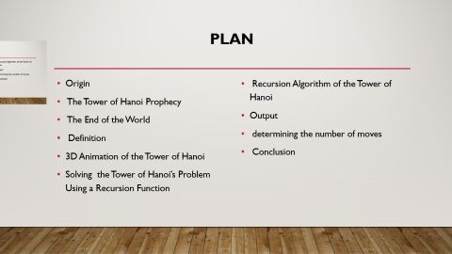
PLAN
Origin
The Tower of Hanoi Prophecy
The End of the World
Definition
3D Animation of the Tower of Hanoi
Solving the Tower of Hanoi’s Problem Using a Recursion Function
Recursion Algorithm of the Tower of Hanoi
Output
determining the number of moves
Conclusion

Slide 3
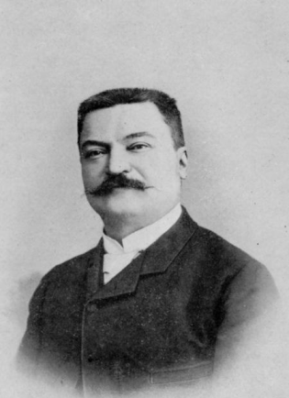

Origin
The Tower of Hanoi puzzle was invented by the French mathematician François Édouard Anatole Lucas in 1883

Slide 4

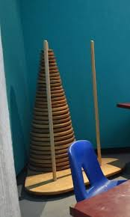
Prophecy

Slide 5
François Édouard Anatole Lucas was inspired by a legend that tells of a Hindu temple where the puzzle was presented to young priests. At the beginning of time, the priests were given three poles and a stack of 64 gold disks, each disk a little smaller than the one beneath it. Their assignment was to transfer all 64 disks from one of the three poles to another, with two important constraints. They could only move one disk at a time, and they could never place a larger disk on top of a smaller one. The priests worked very efficiently, day and night, moving one disk every second. When they finished their work, the legend said, the temple would crumble into dust and the world would vanish.

Slide 6

Time of the End of the world according to the prophecy
The number of moves required to correctly move a tower of 64 disks is 2^64−1=18,446,744,073,709,551,615. At a rate of one move per second, that is 584,942,417,355 Years.

Slide 7
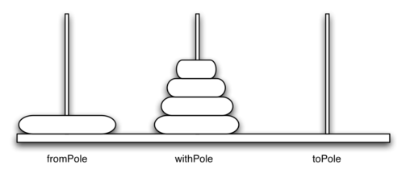
Definition
Tower of Hanoi is a famous game.
In this game, there are three pegs and N number of disks place one over the other in decreasing size.
The objective of this game is to move the disks one by one from the first peg to the last peg. And there is only ONE condition, we can not place a bigger disk on top of a smaller disk.

Slide 8
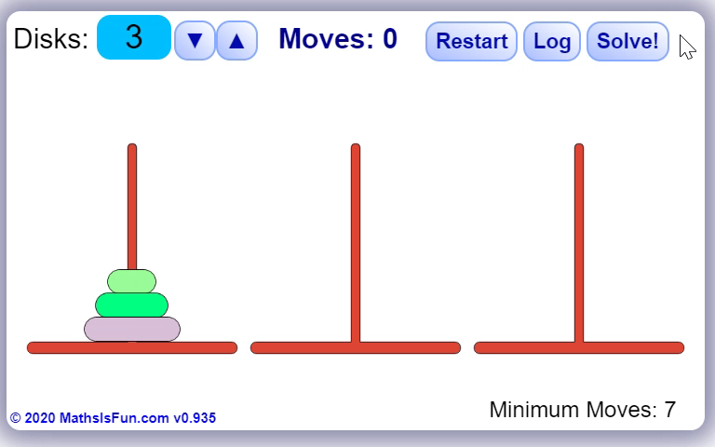
3D ANIMATION OF THE TOWER OF HANOI
PEG A
PEG B
PEG C

Slide 9
C++ Recursion function code
//this is a program solving recursion of 3 disks
#include <iostream>
using namespace std;
void moveDisk(char fp, char tp);
void moveTower(int height, char fromPole, char toPole, char withPole);
int main(){
moveTower(3, 'A', 'B', 'C');
system("pause");
return 0;
}
void moveDisk(char fp, char tp){
cout << "moving disk from " << fp << " to " << tp << endl;
}
void moveTower(int height, char fromPole, char toPole, char withPole)
{
if (height >= 1) {
moveTower(height - 1, fromPole, withPole, toPole); //Recursive call
moveDisk(fromPole, toPole);
moveTower(height - 1, withPole, toPole, fromPole);//Recursive call
}
}

Slide 10
Output and demonstration
moving disk from A to B
moving disk from A to C
moving disk from B to C
moving disk from A to B
moving disk from C to A
moving disk from C to B
moving disk from A to B
PEG A
PEG C
PEG B

Slide 11
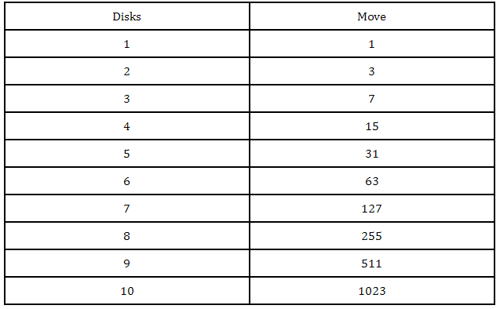
How to determine the number of moves according to the number of disks
The number of moves is calculated by the formulas (2^n)-1. with n the number of disks.
With 3 disks we have:
M = (2^3)-1 = 8-1 = 7

Slide 12
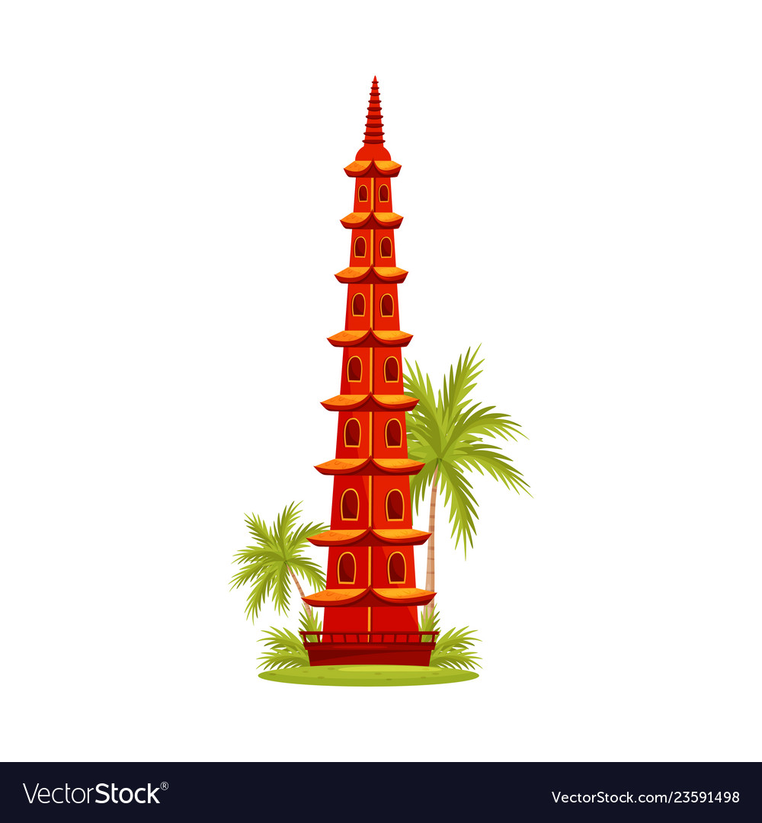
conclusion
The Tower of Hanoi is good example of recursion using that often involves a key insight that makes everything simpler. Often the insight is determining what data exactly we are recursing on - we ask, what is the essential feature of the problem that should change as we call ourselves?
THANK YOU !!!

